Slide 1
Sorting
  arranging elements of set into order
Solution:
  Insertion Sort
  Quicksort
  Mergesort
  Heapsort
  Shellsort
  Radix Sorting

Slide 2
Application of Sorting
For searching on unsorted data by comparing keys, optimal solutions require θ(n) comparisons.
For searching on sorted data by comparing keys, optimal solutions require θ(log n) comparisons.
Sorting data for users
More…

Slide 3
Comparison based sorting:. (eg. insertion sort. merge sort, bubble sort, quick sort etc.
Non-Comparison based sorting: ( eg. bucket sort, radix sort, counting sort etc.)
Internal Sorting: (eg. bubble sort. insertion sort. etc.)
External Sorting: (eg. quick sort. merge sort. etc.)
Stable sorting: (eg. merge sort, insertion sort, bubble sort)
Unstable sorting :(quicksort, heap sort, and selection sort)
Adaptive Sorting : (i.e. sorted or unsorted data eg. bubble sort, insertion sort, quick sort etc)
Non-Adaptive Sorting : (eg. selection sort, merge sort, heap sort etc.)
In-place/Outplace technique – (eg. in comparison based techniques mentioned above only merge sort is outplaced. Among the non-comparison based techniques mentioned above all are outplaced techniques.

Slide 4


Insertion Sort

Slide 5
Insertion Sort
Strategy: Insertion of an element in proper order:
  Begin with a sequence E of n elements in arbitrary order
  Initially assume the sorted segment contains first element
  Let x be the next element to be inserted in sorted segment, pull x “out of the way”, leaving a vacancy
  repeatedly compare x to the element just to the left of the vacancy, and as long as x is smaller, move that element into the vacancy,
  else put x in the vacancy,
  repeat the next element that has not yet examined.
Notes:
The primary strategy used in insertion sort is incremental (or stepwise) approach, where one element is taken from the unsorted part and inserted into its correct position in the sorted portion of the list.
It also follows a decrease-and-conquer strategy, where the problem is reduced to a smaller instance of itself, with the sorted portion acting as the smaller subproblem.

Slide 6
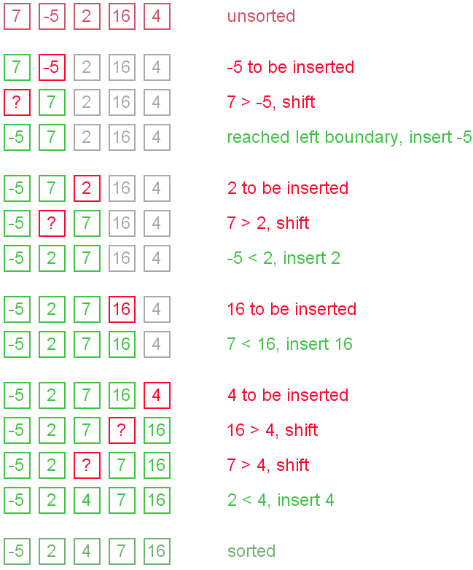
Insertion Sort

Slide 7
Insertion Sort (A)
for j=2 to A.length
key = A[j]
//insert A[j] into sorted sequence A[1..j-1]
i=j-1
while (i>0 and A[i] > key )
A[i+1] =A [i]
i=i-1
A[i+1]= key

Slide 8
Insertion Sort: Analysis
Worst-Case Complexity
  W(n) = O(n²)
  When the elements are in reversed order
Best Case
  W(n) = Omega(n)
  When the elements are already sorted in ascending order
Analysis [no of comparisons/movement ]
F(n) = 1 + 2 + 3 + ………(n-3) +(n-2)+ (n-1)
= n (n-1 ) / 2
= O (n² )

Slide 9
Improvement Analysis
(by reducing number of comparisons and movement)
Reduce number of Comparison
Apply binary search
Reduce number of Movement
-Implement doubly linked list
cannot make total running time better than O(n²)

Slide 10
Video Lecture of the topic can be found at
Insertion Sort Analysis
https://youtu.be/jikkNiuR2CQ

